Slide 1

Estimating the Circuit De-obfuscation Runtime based on Learning Methods

Slide 2
Outline
Introduction
Problem Statement
Related Works
Discussion
Main Questions
Introduction
Introduction of circuit obfuscation and de-obfuscation
Problem Statement
Why the estimating the circuit de-obfuscation runtime is necessary?
Related Works
Introduce related works for estimating the circuit de-obfuscation runtime
Discussion
Discussion about this topic
Main Questions
Main questions for the future work of this topic

Slide 3
Introduction

Slide 4

Introduction
Problem Statement
Related Works
Discussion
Work Reports
Circuit obfuscation
The main costs of semiconductor fabrication are relatively high.
It motivates semiconductor companies to outsource it to off-shore foundries.
Despite its benefits, this trend has led to ever-increasing security risks such as
IC counterfeiting
Piracy and unauthorized overproduction by the contract foundries
The major threats from the attackers arise from reverse engineering (RE) an IC and fully identifying its functionality.
Circuit Obfuscation is a technique by which the description or the structure of electronic hardware is modified to intentionally conceal its functionality.
Notes:
Infertility : inability of couples to achieve pregnancy in one year.
It can have adverse effects on family’s aspects of life.
About 30-50% of infertility cases are due to male factor.
Semen analysis is the first step in diagnosis and treatment of male infertility.
Microscopic parts of semen analysis assess characteristics of sperm cells.

Slide 5
Introduction
Problem Statement
Related Works
Discussion
Work Reports
Circuit obfuscation
The general idea for circuit obfuscation
Introduce the ambiguity in the functionality of the IC so that the while preserving the original functionality.
Such techniques were highly effective until the advent of advanced attacking techniques.
Currently, Boolean satisfiability problem (SAT)-based attacks have attracted enormous attention because of their optimum performance for reverse engineering (RE) an IC and fully identifying its functionality.
Notes:
Infertility : inability of couples to achieve pregnancy in one year.
It can have adverse effects on family’s aspects of life.
About 30-50% of infertility cases are due to male factor.
Semen analysis is the first step in diagnosis and treatment of male infertility.
Microscopic parts of semen analysis assess characteristics of sperm cells.

Slide 6
Introduction
Problem Statement
Related Works
Discussion
Work Reports
SAT Attacks
The runtime of the SAT attacks depends on circuit topology and the number and location of obfuscated gates.
It can vary from milliseconds to years or more
A successful obfuscation defense is to increase the amount of runtime of the SAT attacks.
The obfuscation policy tries to select a set of gates such that maximum obfuscation can be achieved while incurring minimal overheads.
However, until now it is still generally based on human heuristics or experience, which is seriously arbitrary and sub-optimal.
The running time of SAT attacks for to reverse engineer the IC
From milliseconds
To years or more
Notes:
Infertility : inability of couples to achieve pregnancy in one year.
It can have adverse effects on family’s aspects of life.
About 30-50% of infertility cases are due to male factor.
Semen analysis is the first step in diagnosis and treatment of male infertility.
Microscopic parts of semen analysis assess characteristics of sperm cells.

Slide 7
Problem Statement

Slide 8
Introduction
Problem Statement
Related Works
Discussion
Work Reports
Why we should estimate the running time of SAT attacks?
In obfuscation process, it is necessary to estimate the running time of SAT attacks on obfuscated circuits.
It evaluates the resistant of the obfuscated circuits against SAT attacks.
Based on the estimated the running time of SAT attacks, we can classify the different obfuscation samples to SAT-resilient and SAT-vulnerable classes.
SAT-resilient
However, the runtime of SAT attacks for each execution can be days, weeks, or years.
As a result, it requires an intelligent system to estimate quickly and accurately the running time of SAT attacks.
Obfuscated circuits
SAT-vulnerable
Notes:
Infertility : inability of couples to achieve pregnancy in one year.
It can have adverse effects on family’s aspects of life.
About 30-50% of infertility cases are due to male factor.
Semen analysis is the first step in diagnosis and treatment of male infertility.
Microscopic parts of semen analysis assess characteristics of sperm cells.

Slide 9
Introduction
Problem Statement
Related Works
Discussion
Work Reports
The challenges of automatic estimating the running time of SAT attacks?
The automatic estimating the running time of SAT attacks is highly underexplored because of its significant challenges.
These challenges are
1
2
3
Difficulty in characterizing the hidden and sophisticated algorithmic mechanism of attackers.
Challenge in extracting determinant features from discrete and graph-structured IC
Requirement on high efficiency and scalability for de-obfuscation runtime estimation
The main data for estimating the running time of SAT attacks
Circuit
Topology
Gates’s Information
Notes:
Infertility : inability of couples to achieve pregnancy in one year.
It can have adverse effects on family’s aspects of life.
About 30-50% of infertility cases are due to male factor.
Semen analysis is the first step in diagnosis and treatment of male infertility.
Microscopic parts of semen analysis assess characteristics of sperm cells.

Slide 10

Introduction
Problem Statement
Related Works
Discussion
Work Reports
A good choice for estimating the running time of SAT attacks
Graph neural networks (GNNs) techniques are good choices for automatic estimating the running time of SAT attacks because of its characteristics.
GNN
Graph Structure (Circuit Topology)
Estimation of running time of SAT attacks
Nodes’ features
(Gates’s Information)
Notes:
Infertility : inability of couples to achieve pregnancy in one year.
It can have adverse effects on family’s aspects of life.
About 30-50% of infertility cases are due to male factor.
Semen analysis is the first step in diagnosis and treatment of male infertility.
Microscopic parts of semen analysis assess characteristics of sperm cells.

Slide 11

Introduction
Problem Statement
Related Works
Discussion
Work Reports
The setup for creating a framework to automatic estimation of running of SAT attacks
Data Acquisition
Data Processing
Machine Learning
Deployment
Collecting Circuits
Applying SAT attacks to the Circuits
Generating and collecting running time of SAT solvers for each circuit
Implement graph representation of each circuit
Feature design of each element of each circuit
Collecting the inputs (Graphs and Features) and outputs (Running time of SAT solvers) for implementing machine learning framework
Training the learning framework to predict the running time of SAT solvers
Testing and validating the framework
Fine-tuning
Applying a circuit to the trained model with graph structure and features of nodes to estimate the running time of SAT attacks
Notes:
Infertility : inability of couples to achieve pregnancy in one year.
It can have adverse effects on family’s aspects of life.
About 30-50% of infertility cases are due to male factor.
Semen analysis is the first step in diagnosis and treatment of male infertility.
Microscopic parts of semen analysis assess characteristics of sperm cells.

Slide 12
Related Works

Slide 13
Introduction
Problem Statement
Related Works
Discussion
Work Reports
Literate Review of Estimating the Circuit De-obfuscation Runtime
Paper | Author Name (Year) | Learning Method | Dataset
[1] | Chen et al. (2020) | A concatenation of graph convolutional network and neural network called ICNet | Obtained by running SAT algorithm on real-world ISCAS-85 benchmark
[2] | -- | A graph neural network called CNF-NET which leverages the conjunctive normal form (CNF)-based bipartite graph and Restricted Boltzmann Machine | Obtained by running SAT algorithm on real-world ISCAS-85 benchmark
[1] Chen, Zhiqian, et al. "Estimating the circuit de-obfuscation runtime based on graph deep learning." 2020 Design, Automation & Test in Europe Conference & Exhibition (DATE). IEEE, 2020.
[2] SEPIANN: Security Evaluation Platform for SAT-Hardness using Intelligent Artificial Neural Net, Under publish
Notes:
Infertility : inability of couples to achieve pregnancy in one year.
It can have adverse effects on family’s aspects of life.
About 30-50% of infertility cases are due to male factor.
Semen analysis is the first step in diagnosis and treatment of male infertility.
Microscopic parts of semen analysis assess characteristics of sperm cells.

Slide 14
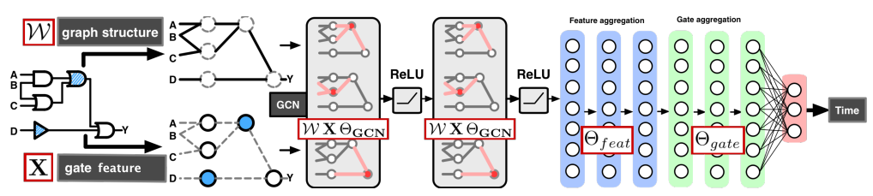
Introduction
Problem Statement
Related Works
Discussion
Work Reports
Literate Review of Estimating the Circuit De-obfuscation Runtime
The proposed method in Estimating the circuit de-obfuscation runtime based on graph deep learning [1]
[1] Chen, Zhiqian, et al. "Estimating the circuit de-obfuscation runtime based on graph deep learning." 2020 Design, Automation & Test in Europe Conference & Exhibition (DATE). IEEE, 2020.
Notes:
Infertility : inability of couples to achieve pregnancy in one year.
It can have adverse effects on family’s aspects of life.
About 30-50% of infertility cases are due to male factor.
Semen analysis is the first step in diagnosis and treatment of male infertility.
Microscopic parts of semen analysis assess characteristics of sperm cells.

Slide 15
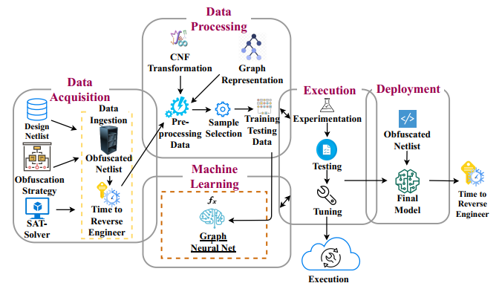
Introduction
Problem Statement
Related Works
Discussion
Work Reports
Literate Review of Estimating the Circuit De-obfuscation Runtime
The proposed framework in SEPIANN: Security Evaluation Platform for SAT-Hardness using Intelligent Artificial Neural Net [2]
[2] SEPIANN: Security Evaluation Platform for SAT-Hardness using Intelligent Artificial Neural Net, Under publish
Notes:
Infertility : inability of couples to achieve pregnancy in one year.
It can have adverse effects on family’s aspects of life.
About 30-50% of infertility cases are due to male factor.
Semen analysis is the first step in diagnosis and treatment of male infertility.
Microscopic parts of semen analysis assess characteristics of sperm cells.

Slide 16
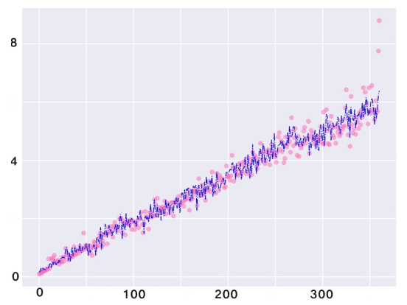
Introduction
Problem Statement
Related Works
Discussion
Work Reports
Literate Review of Estimating the Circuit De-obfuscation Runtime
A sample result of the proposed method in[1]. Pink dot are real values, blue lines are the predictions. x-axis is data index in testing data while y-axis is runtime value in log scale.
[1] Chen, Zhiqian, et al. "Estimating the circuit de-obfuscation runtime based on graph deep learning." 2020 Design, Automation & Test in Europe Conference & Exhibition (DATE). IEEE, 2020.
Notes:
Infertility : inability of couples to achieve pregnancy in one year.
It can have adverse effects on family’s aspects of life.
About 30-50% of infertility cases are due to male factor.
Semen analysis is the first step in diagnosis and treatment of male infertility.
Microscopic parts of semen analysis assess characteristics of sperm cells.

Slide 17
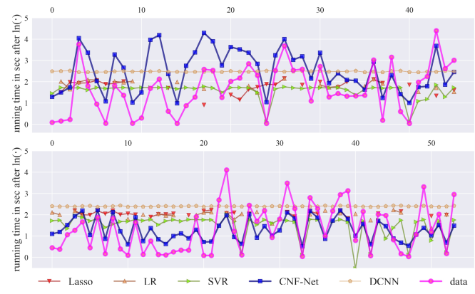
Introduction
Problem Statement
Related Works
Discussion
Work Reports
Literate Review of Estimating the Circuit De-obfuscation Runtime
A sample result of the proposed method in[2]. x-axis is data index in testing data while y-axis is runtime value in log scale.
[2] SEPIANN: Security Evaluation Platform for SAT-Hardness using Intelligent Artificial Neural Net, Under publish
Notes:
Infertility : inability of couples to achieve pregnancy in one year.
It can have adverse effects on family’s aspects of life.
About 30-50% of infertility cases are due to male factor.
Semen analysis is the first step in diagnosis and treatment of male infertility.
Microscopic parts of semen analysis assess characteristics of sperm cells.

Slide 18
Discussion

Slide 19
Introduction
Problem Statement
Related Works
Discussion
Work Reports
Discussion about Estimating the Circuit De-obfuscation Runtime
SAT attacks currently could obfuscate different circuits
This issue is highly underexplored because of its significant challenges
The Necessity of improving the estimating the circuit de-obfuscation runtime
Reasons for improving the estimating the circuit de-obfuscation runtime
Notes:
Infertility : inability of couples to achieve pregnancy in one year.
It can have adverse effects on family’s aspects of life.
About 30-50% of infertility cases are due to male factor.
Semen analysis is the first step in diagnosis and treatment of male infertility.
Microscopic parts of semen analysis assess characteristics of sperm cells.

Slide 20
Introduction
Problem Statement
Related Works
Discussion
Work Reports
Main questions and future work of estimating the circuit de-obfuscation runtime
Main Questions?
Is the dataset for implementing learning framework available?
What is the main features of each gate in the circuit?
The graph deep learning techniques are good choices for estimating the circuit de-obfuscation runtime, but how to improve that?
Combining traditional learning methods such as feature selection to graph deep learning techniques could be considered
Notes:
Infertility : inability of couples to achieve pregnancy in one year.
It can have adverse effects on family’s aspects of life.
About 30-50% of infertility cases are due to male factor.
Semen analysis is the first step in diagnosis and treatment of male infertility.
Microscopic parts of semen analysis assess characteristics of sperm cells.

Slide 21
Work Report

Slide 22
Introduction
Problem Statement
Related Works
Discussion
Work Reports
Main conducted works for this project until now
Study the theoretical concepts of GNNs
Implement GNN models using public benchmarks
Extracting graph structure from obfuscated circuits
Notes:
Infertility : inability of couples to achieve pregnancy in one year.
It can have adverse effects on family’s aspects of life.
About 30-50% of infertility cases are due to male factor.
Semen analysis is the first step in diagnosis and treatment of male infertility.
Microscopic parts of semen analysis assess characteristics of sperm cells.

Slide 23
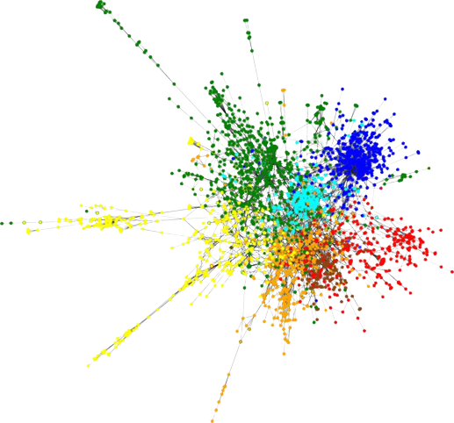
Introduction
Problem Statement
Related Works
Discussion
Work Reports
Implement GNN models using public benchmarks
Firstly, we attempted to perform node classification of CORA dataset using an GNN model.
Secondly, we implemented an GNN model for performing graph classification task
CORA dataset
It consists of 2708 scientific publications.
It classified into one of seven classes (2708 nodes).
The citation network consists of 5429 links (5429 edges).
Training subset: 140 nodes
Validation subset: 500 nodes
Testing subset: 1000 nodes
Graph visualization of CORA dataset
Notes:
Infertility : inability of couples to achieve pregnancy in one year.
It can have adverse effects on family’s aspects of life.
About 30-50% of infertility cases are due to male factor.
Semen analysis is the first step in diagnosis and treatment of male infertility.
Microscopic parts of semen analysis assess characteristics of sperm cells.

Slide 24
Introduction
Problem Statement
Related Works
Discussion
Work Reports
Explaining the GNN model code for CORA dataset classification
1
!pip install torch-geometric
!pip install torch
!pip install torch-sparse
!pip install torch-scatter
Installing necessary libraries and modules
2
import numpy as np
import matplotlib.pyplot as plt
import torch
import torch.nn.functional as F
from torch_geometric.datasets import Planetoid
from torch_geometric.nn import GCNConv
Importing libraries and modules
Notes:
Infertility : inability of couples to achieve pregnancy in one year.
It can have adverse effects on family’s aspects of life.
About 30-50% of infertility cases are due to male factor.
Semen analysis is the first step in diagnosis and treatment of male infertility.
Microscopic parts of semen analysis assess characteristics of sperm cells.

Slide 25
Introduction
Problem Statement
Related Works
Discussion
Work Reports
Explaining the GNN model code for CORA dataset classification
3
dataset = Planetoid(root='/tmp/Cora', name='Cora')
print(dataset.num_classes)
print(dataset.num_features)
print(dataset[0])
print(dataset[0].train_mask.sum())
print(dataset[0].val_mask.sum())
print(dataset[0].test_mask.sum())
Importing CORA dataset and printing its characteristics
Code results
7
1433
Data(x=[2708, 1433], edge_index=[2, 10556], y=[2708], train_mask=[2708], val_mask=[2708], test_mask=[2708])
tensor(140)
tensor(500)
tensor(1000)
Notes:
Infertility : inability of couples to achieve pregnancy in one year.
It can have adverse effects on family’s aspects of life.
About 30-50% of infertility cases are due to male factor.
Semen analysis is the first step in diagnosis and treatment of male infertility.
Microscopic parts of semen analysis assess characteristics of sperm cells.

Slide 26
Introduction
Problem Statement
Related Works
Discussion
Work Reports
Explaining the GNN model code for CORA dataset classification
4
class GCN(torch.nn.Module):
def __init__(self):
super().__init__()
self.conv1 = GCNConv(dataset.num_node_features, 16)
self.conv2 = GCNConv(16, dataset.num_classes)
def forward(self, data):
x, edge_index = data.x, data.edge_index
x = self.conv1(x, edge_index)
x = F.relu(x)
x = F.dropout(x, training=self.training)
x = self.conv2(x, edge_index)
return F.log_softmax(x, dim=1)
Configuring the structure of the GNN model
Notes:
Infertility : inability of couples to achieve pregnancy in one year.
It can have adverse effects on family’s aspects of life.
About 30-50% of infertility cases are due to male factor.
Semen analysis is the first step in diagnosis and treatment of male infertility.
Microscopic parts of semen analysis assess characteristics of sperm cells.

Slide 27
Introduction
Problem Statement
Related Works
Discussion
Work Reports
Explaining the GNN model code for CORA dataset classification
5
device = torch.device('cuda' if torch.cuda.is_available() else 'cpu')
model = GCN().to(device)
data = dataset[0].to(device)
optimizer = torch.optim.Adam(model.parameters(),
lr=0.01, weight_decay=5e-4) losses = []
Epochs = 200
model.train()
for epoch in range(Epochs):
optimizer.zero_grad()
out = model(data)
loss = F.nll_loss(out[data.train_mask], data.y[data.train_mask])
loss.backward()
optimizer.step()
losses.append(loss.detach().numpy())
print(f"Epoch: {epoch}\tLoss: {loss:.4f}")
Training the GNN model
Notes:
Infertility : inability of couples to achieve pregnancy in one year.
It can have adverse effects on family’s aspects of life.
About 30-50% of infertility cases are due to male factor.
Semen analysis is the first step in diagnosis and treatment of male infertility.
Microscopic parts of semen analysis assess characteristics of sperm cells.

Slide 28
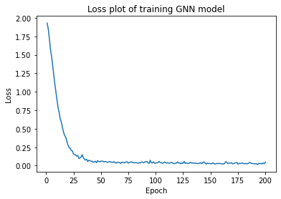
Introduction
Problem Statement
Related Works
Discussion
Work Reports
Explaining the GNN model code for CORA dataset classification
6
plt.plot(np.arange(1,Epochs+1), np.asarray(losses))
plt.title('Loss plot of training GNN model')
plt.xlabel('Epoch')
plt.ylabel('Loss')
Plotting the loss values of the GNN model during training phase
Notes:
Infertility : inability of couples to achieve pregnancy in one year.
It can have adverse effects on family’s aspects of life.
About 30-50% of infertility cases are due to male factor.
Semen analysis is the first step in diagnosis and treatment of male infertility.
Microscopic parts of semen analysis assess characteristics of sperm cells.

Slide 29
Introduction
Problem Statement
Related Works
Discussion
Work Reports
Explaining the GNN model code for CORA dataset classification
8
model.eval()
pred = model(data).argmax(dim=1)
correct = (pred[data.test_mask] == data.y[data.test_mask]).sum()
acc = int(correct) / int(data.test_mask.sum())
print(f'Accuracy: {acc:.4f}')
Testing the trained model using the testing set
Code results
Accuracy: 0.7910
Notes:
Infertility : inability of couples to achieve pregnancy in one year.
It can have adverse effects on family’s aspects of life.
About 30-50% of infertility cases are due to male factor.
Semen analysis is the first step in diagnosis and treatment of male infertility.
Microscopic parts of semen analysis assess characteristics of sperm cells.

Slide 30
Introduction
Problem Statement
Related Works
Discussion
Work Reports
Implement an GNN model for graph classification task
Graph classification refers to the problem of classifying entire graphs (in contrast to nodes)
Graph classification framework is more compatible for estimating the circuit de-obfuscation runtime
MUTAG dataset
This dataset provides 188 different graphs
Each graph in the dataset represents a chemical compound
The graph labels represent "their mutagenic effect on a specific gram negative bacterium".
The task is to classify each graph into one out of two classes.
Notes:
Infertility : inability of couples to achieve pregnancy in one year.
It can have adverse effects on family’s aspects of life.
About 30-50% of infertility cases are due to male factor.
Semen analysis is the first step in diagnosis and treatment of male infertility.
Microscopic parts of semen analysis assess characteristics of sperm cells.

Slide 31
Introduction
Problem Statement
Related Works
Discussion
Work Reports
Explaining the GNN model code for MUTAG dataset classification
1
!pip install torch-geometric
!pip install torch
!pip install torch-sparse
!pip install torch-scatter
Installing necessary libraries and modules
2
import numpy as np
import matplotlib.pyplot as plt
import torch
from torch_geometric.datasets import TUDataset
from torch_geometric.loader import DataLoader
from torch.nn import Linear
import torch.nn.functional as F
from torch_geometric.nn import GCNConv
from torch_geometric.nn import global_mean_pool
Importing libraries and modules
Notes:
Infertility : inability of couples to achieve pregnancy in one year.
It can have adverse effects on family’s aspects of life.
About 30-50% of infertility cases are due to male factor.
Semen analysis is the first step in diagnosis and treatment of male infertility.
Microscopic parts of semen analysis assess characteristics of sperm cells.

Slide 32
Introduction
Problem Statement
Related Works
Discussion
Work Reports
Explaining the GNN model code for MUTAG dataset classification
3
dataset = TUDataset(root='data/TUDataset', name='MUTAG') print(f'Dataset: {dataset}:')
print('====================')
print(f'Number of graphs: {len(dataset)}')
print(f'Number of features: {dataset.num_features}')
print(f'Number of classes: {dataset.num_classes}')
data = dataset[0]
print(data)
Importing MUTAG dataset and printing its characteristics
Code results
Dataset: MUTAG(188):
====================
Number of graphs: 188
Number of features: 7
Number of classes: 2
Data(edge_index=[2, 38], x=[17, 7], edge_attr=[38, 4], y=[1])
Notes:
Infertility : inability of couples to achieve pregnancy in one year.
It can have adverse effects on family’s aspects of life.
About 30-50% of infertility cases are due to male factor.
Semen analysis is the first step in diagnosis and treatment of male infertility.
Microscopic parts of semen analysis assess characteristics of sperm cells.

Slide 33
Introduction
Problem Statement
Related Works
Discussion
Work Reports
Explaining the GNN model code for MUTAG dataset classification
4
torch.manual_seed(12345)
dataset = dataset.shuffle()
train_dataset = dataset[:150]
test_dataset = dataset[150:]
print(f'Number of training graphs: {len(train_dataset)}')
print(f'Number of test graphs: {len(test_dataset)}')
Splitting dataset to the training and testing subsets
Code results
Number of training graphs: 150
Number of test graphs: 38
5
train_loader = DataLoader(train_dataset, batch_size=64,
shuffle=True)
test_loader = DataLoader(test_dataset, batch_size=64,
shuffle=False)
Mini-batching of training and testing subsets
Notes:
Infertility : inability of couples to achieve pregnancy in one year.
It can have adverse effects on family’s aspects of life.
About 30-50% of infertility cases are due to male factor.
Semen analysis is the first step in diagnosis and treatment of male infertility.
Microscopic parts of semen analysis assess characteristics of sperm cells.

Slide 34
Introduction
Problem Statement
Related Works
Discussion
Work Reports
6
Explaining the GNN model code for MUTAG dataset classification
class GCN(torch.nn.Module):
def __init__(self, hidden_channels):
super(GCN, self).__init__()
torch.manual_seed(12345)
self.conv1 = GCNConv(dataset.num_node_features, hidden_channels)
self.conv2 = GCNConv(hidden_channels, hidden_channels)
self.conv3 = GCNConv(hidden_channels, hidden_channels)
self.lin = Linear(hidden_channels, dataset.num_classes) def forward(self, x, edge_index, batch):
x = self.conv1(x, edge_index)
x = x.relu()
x = self.conv2(x, edge_index)
x = x.relu()
x = self.conv3(x, edge_index)
x = global_mean_pool(x, batch) x = F.dropout(x, p=0.5, training=self.training)
x = self.lin(x)
return x model = GCN(hidden_channels=64)
Configuring the structure of the GNN model
Notes:
Infertility : inability of couples to achieve pregnancy in one year.
It can have adverse effects on family’s aspects of life.
About 30-50% of infertility cases are due to male factor.
Semen analysis is the first step in diagnosis and treatment of male infertility.
Microscopic parts of semen analysis assess characteristics of sperm cells.

Slide 35
Introduction
Problem Statement
Related Works
Discussion
Work Reports
7
Explaining the GNN model code for MUTAG dataset classification
model = GCN(hidden_channels=64)
optimizer = torch.optim.Adam(model.parameters(), lr=0.01)
criterion = torch.nn.CrossEntropyLoss()
Configuring the training settings of the GNN model
8
def train():
model.train()
for data in train_loader:
out = model(data.x, data.edge_index, data.batch)
loss = criterion(out, data.y)
loss.backward()
optimizer.step()
optimizer.zero_grad()
Defining the training function
Notes:
Infertility : inability of couples to achieve pregnancy in one year.
It can have adverse effects on family’s aspects of life.
About 30-50% of infertility cases are due to male factor.
Semen analysis is the first step in diagnosis and treatment of male infertility.
Microscopic parts of semen analysis assess characteristics of sperm cells.

Slide 36
Introduction
Problem Statement
Related Works
Discussion
Work Reports
9
Explaining the GNN model code for MUTAG dataset classification
def test(loader):
model.eval()
correct = 0
for data in loader:
out = model(data.x, data.edge_index, data.batch)
pred = out.argmax(dim=1)
correct += int((pred == data.y).sum())
return correct / len(loader.dataset)
Defining the testing function
8
for epoch in range(1, 171):
train()
train_acc = test(train_loader)
test_acc = test(test_loader)
print(f'Epoch: {epoch:03d}, Train Acc: {train_acc:.4f},
Test Acc: {test_acc:.4f}')
Training the model during 170 epochs
Notes:
Infertility : inability of couples to achieve pregnancy in one year.
It can have adverse effects on family’s aspects of life.
About 30-50% of infertility cases are due to male factor.
Semen analysis is the first step in diagnosis and treatment of male infertility.
Microscopic parts of semen analysis assess characteristics of sperm cells.

Slide 37
Introduction
Problem Statement
Related Works
Discussion
Work Reports
Explaining the GNN model code for MUTAG dataset classification
Code results
Epoch: 157, Train Acc: 0.8000, Test Acc: 0.7368
Epoch: 158, Train Acc: 0.7800, Test Acc: 0.7368
Epoch: 159, Train Acc: 0.7867, Test Acc: 0.7632
Epoch: 160, Train Acc: 0.7867, Test Acc: 0.7632
Epoch: 161, Train Acc: 0.7800, Test Acc: 0.7632
Epoch: 162, Train Acc: 0.7867, Test Acc: 0.7632
Epoch: 163, Train Acc: 0.7867, Test Acc: 0.7632
Epoch: 164, Train Acc: 0.7800, Test Acc: 0.8158
Epoch: 165, Train Acc: 0.7800, Test Acc: 0.8158
Epoch: 166, Train Acc: 0.7733, Test Acc: 0.7632
Epoch: 167, Train Acc: 0.7867, Test Acc: 0.7895
Epoch: 168, Train Acc: 0.7867, Test Acc: 0.7895
Epoch: 169, Train Acc: 0.8000, Test Acc: 0.7632
Epoch: 170, Train Acc: 0.8000, Test Acc: 0.7632
Notes:
Infertility : inability of couples to achieve pregnancy in one year.
It can have adverse effects on family’s aspects of life.
About 30-50% of infertility cases are due to male factor.
Semen analysis is the first step in diagnosis and treatment of male infertility.
Microscopic parts of semen analysis assess characteristics of sperm cells.

Slide 38
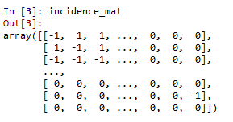
Introduction
Problem Statement
Related Works
Discussion
Work Reports
Extracting graph structure from obfuscated circuits
In the first step, we transformed each bench file to the CNF representation
Sample Code
import numpy as np
import os
from bench2cnf import simple_read_bench, tseytin_t, cnf_to_matrix
import time as TT File_link = os.path.join(os.getcwd(),"5_per.bench") wires = simple_read_bench(File_link)
cnf_clause_count, cnf_content = tseytin_t(wires)
incidence_mat = cnf_to_matrix(cnf_content)
Notes:
Infertility : inability of couples to achieve pregnancy in one year.
It can have adverse effects on family’s aspects of life.
About 30-50% of infertility cases are due to male factor.
Semen analysis is the first step in diagnosis and treatment of male infertility.
Microscopic parts of semen analysis assess characteristics of sperm cells.

Slide 39
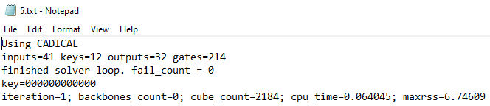
Introduction
Problem Statement
Related Works
Discussion
Work Reports
Extracting graph structure from obfuscated circuits
Also, we implemented a code for collecting the targets (running times) of each circuit
Sample Code
Target_link = os.path.join(os.getcwd(),"5.txt")
f = open(Target_link, "r")
for line in f:
if "cpu_time" in line:
Desired_line = line
break
Desired_List = Desired_line.split(';')
Target = float(Desired_List[3].split('=')[-1])
f.close()
Code results
print(Target)
0.064045
Notes:
Infertility : inability of couples to achieve pregnancy in one year.
It can have adverse effects on family’s aspects of life.
About 30-50% of infertility cases are due to male factor.
Semen analysis is the first step in diagnosis and treatment of male infertility.
Microscopic parts of semen analysis assess characteristics of sperm cells.

Slide 40
Introduction
Problem Statement
Related Works
Discussion
Work Reports
Extracting graph structure from obfuscated circuits
Furthermore, we implemented a code called Data generator which automatically extracts the CNF and targets for each IC and saves them to pickle files.
However, some issues are not clear for us to implement GNN models for estimating the circuit de-obfuscation runtime
Issus:
The features of each gate(node) are not clear
How to extract the adjacency matrix for each circuit?
Could CNF matrix represent the adjacency matrix?
What do the rows and columns of CNF matrix represent?
Notes:
Infertility : inability of couples to achieve pregnancy in one year.
It can have adverse effects on family’s aspects of life.
About 30-50% of infertility cases are due to male factor.
Semen analysis is the first step in diagnosis and treatment of male infertility.
Microscopic parts of semen analysis assess characteristics of sperm cells.

